Slide 1


Domina la Graph API, domina el mundo
Luis Mañez
Notes:
Template may be modified but please keep the title and the sponsor slide.
Twitter hashtag: #spsbcn for all sessions

Slide 2

Luis Mañez
Office Development MVP
@luismanez
https://github.com/luismanez

Slide 3
















Platinum
Gold
Silver
Bronze
SharePint
Raffle
Organized by
Notes:
Use this as the first slide in your slide deck

Slide 4
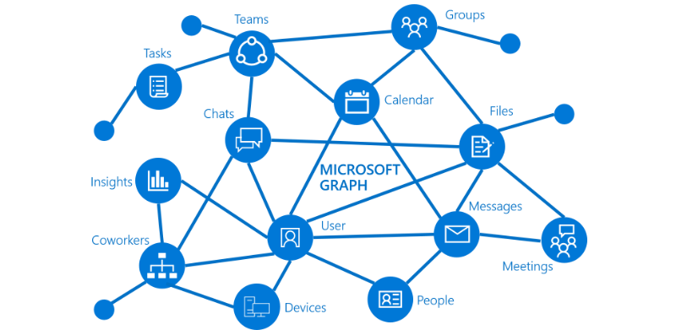
Que es MS Graph?

Slide 5
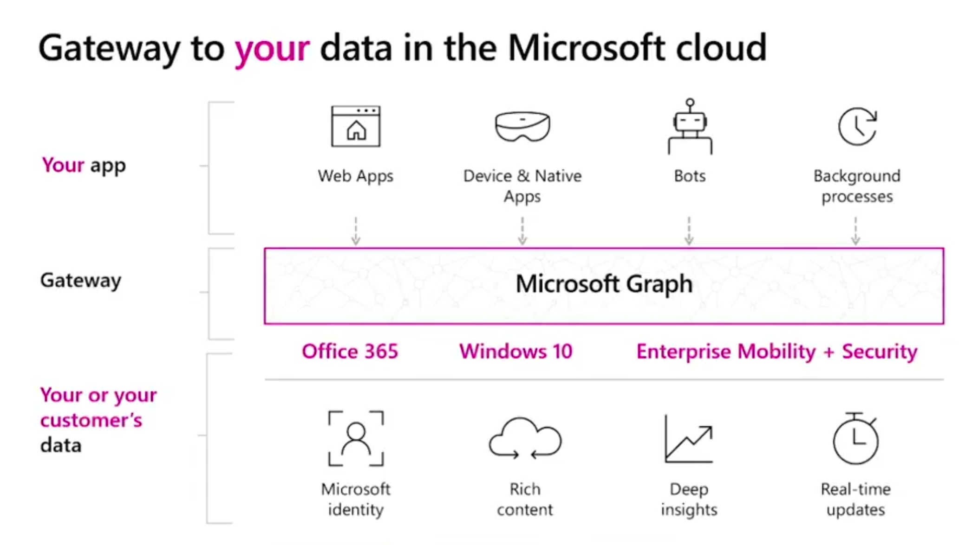

Slide 6
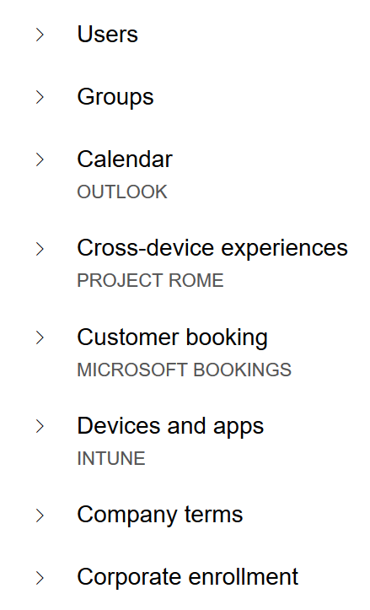
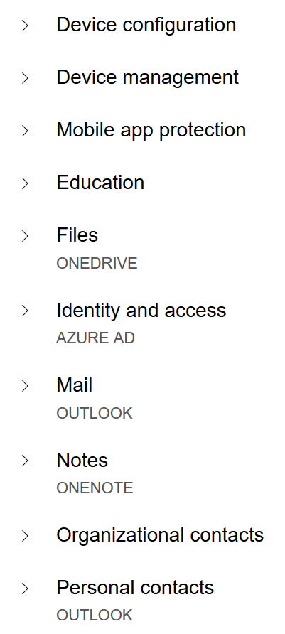
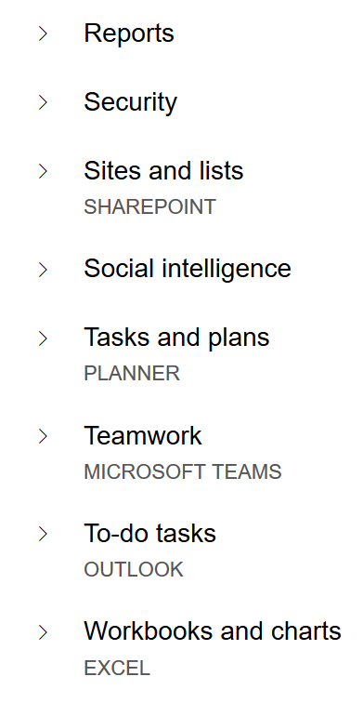
MS Graph Endpoints

Slide 7
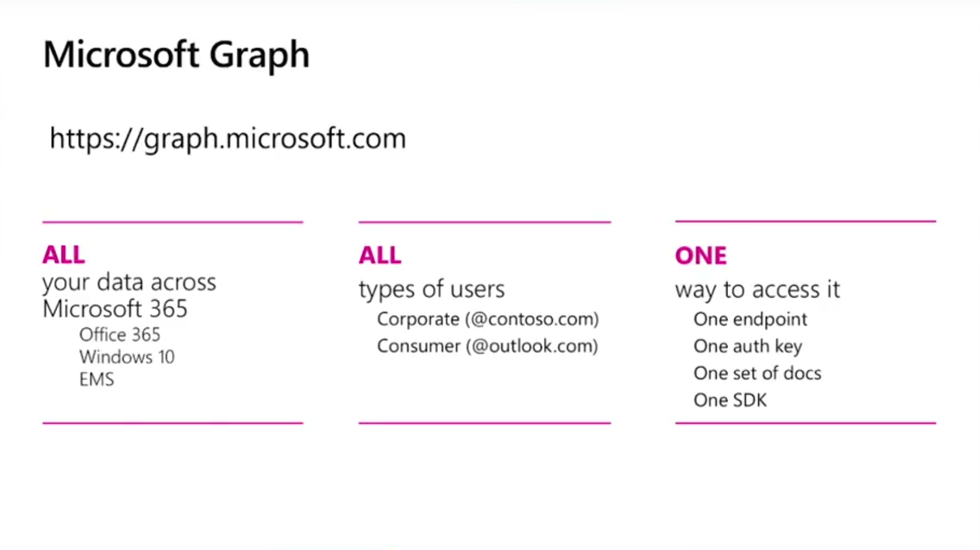

Slide 8

Azure AD Authentication

Slide 9
Azure AD Conceptos
Azure AD Auth esta basado en oAuth 2.0 y OpenIdConnect
MS Graph require un Access Token de Azure AD para ser consumida
Registrar App en Azure AD
Azure V1 vs v2 Endpoint
Asignar permisos
Consent Framework

Slide 10
Azure AD v1 vs v2 endpoints
V1 endpoint
V2 endpoint
Portal | portal.azure.com | apps.dev.microsoft.com portal.azure.com (preview)
Accounts supported | Work / School | Work / School / Personal
Set of APIs | ALL (Graph, SharePoint, Intune, Skype…) | Only Graph API ALL
Multiple Platforms in App | No | Yes
Scopes | Resource | Request
Consents | Static | Dynamic
Multi-Tenant | Requires configuration | By default
Nuget Package | Microsoft.IdentityModel.Clients.ActiveDirectory | Microsoft.Identity.Client (pre-release)
https://docs.microsoft.com/en-us/azure/active-directory/develop/active-directory-v2-limitations
https://docs.microsoft.com/en-us/azure/active-directory/develop/active-directory-v2-compare

Slide 11










Escenarios de consumo

Slide 12
Escenarios de consumo
Mobile and native apps | Web apps and web APIs | Integrate directly with protocols
Add sign-in to an iOS application | Add sign-in to a JavaScript Single Page Application (SPA) | Register an application
Add sign-in to an Android application | Add sign-in to a ASP.NET application | Mobile applications with the OAuth 2.0 protocol
Add sign-in to a Windows Desktop application | Add sign-in to a ASP.NET Core Web application | Web applications with the OpenID Connect protocol
Add sign-in to a multi-platform Xamarin application | Add sign-in to a Node.js web application | JavaScript SPAs with the OpenID Connect protocol
 | Protect an ASP.NET Web API | Daemon applications with the OAuth 2.0 client credentials flow
 | Protect an ASP.NET Core Web API
https://docs.microsoft.com/en-us/azure/active-directory/develop/active-directory-appmodel-v2-overview
https://docs.microsoft.com/en-us/azure/active-directory/develop/active-directory-v2-protocols

Slide 13


A que me ha quedao bonica la demo?...

Slide 14

MS Graph Extensions

Slide 15
MS Graph extensions
Permite almacenar nuestros propios datos en MS Graph.
Ejemplo: ampliar los datos de un usuario con “su color favorito”
Open extensions
Estructura flexible
Key-Value list
Schema extensions
Datos “tipados”
Validacion de tipos

Slide 16
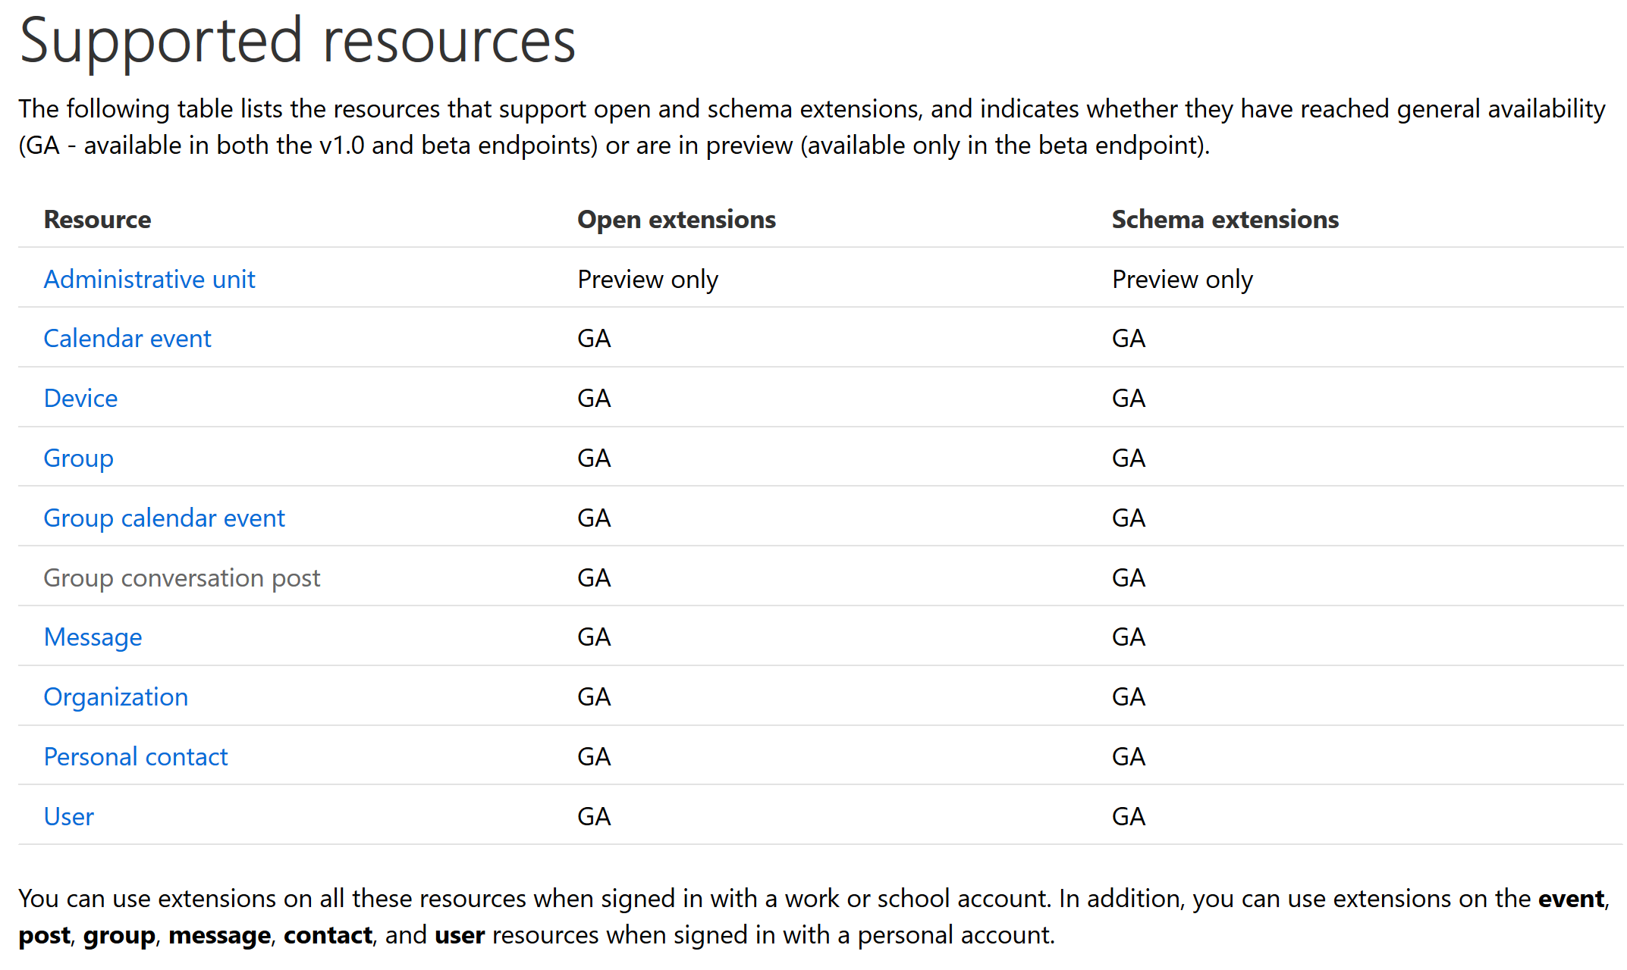
MS Graph extensions

Slide 17
A que me ha quedao bonica la demo?...

Slide 18

Batch Requests

Slide 19
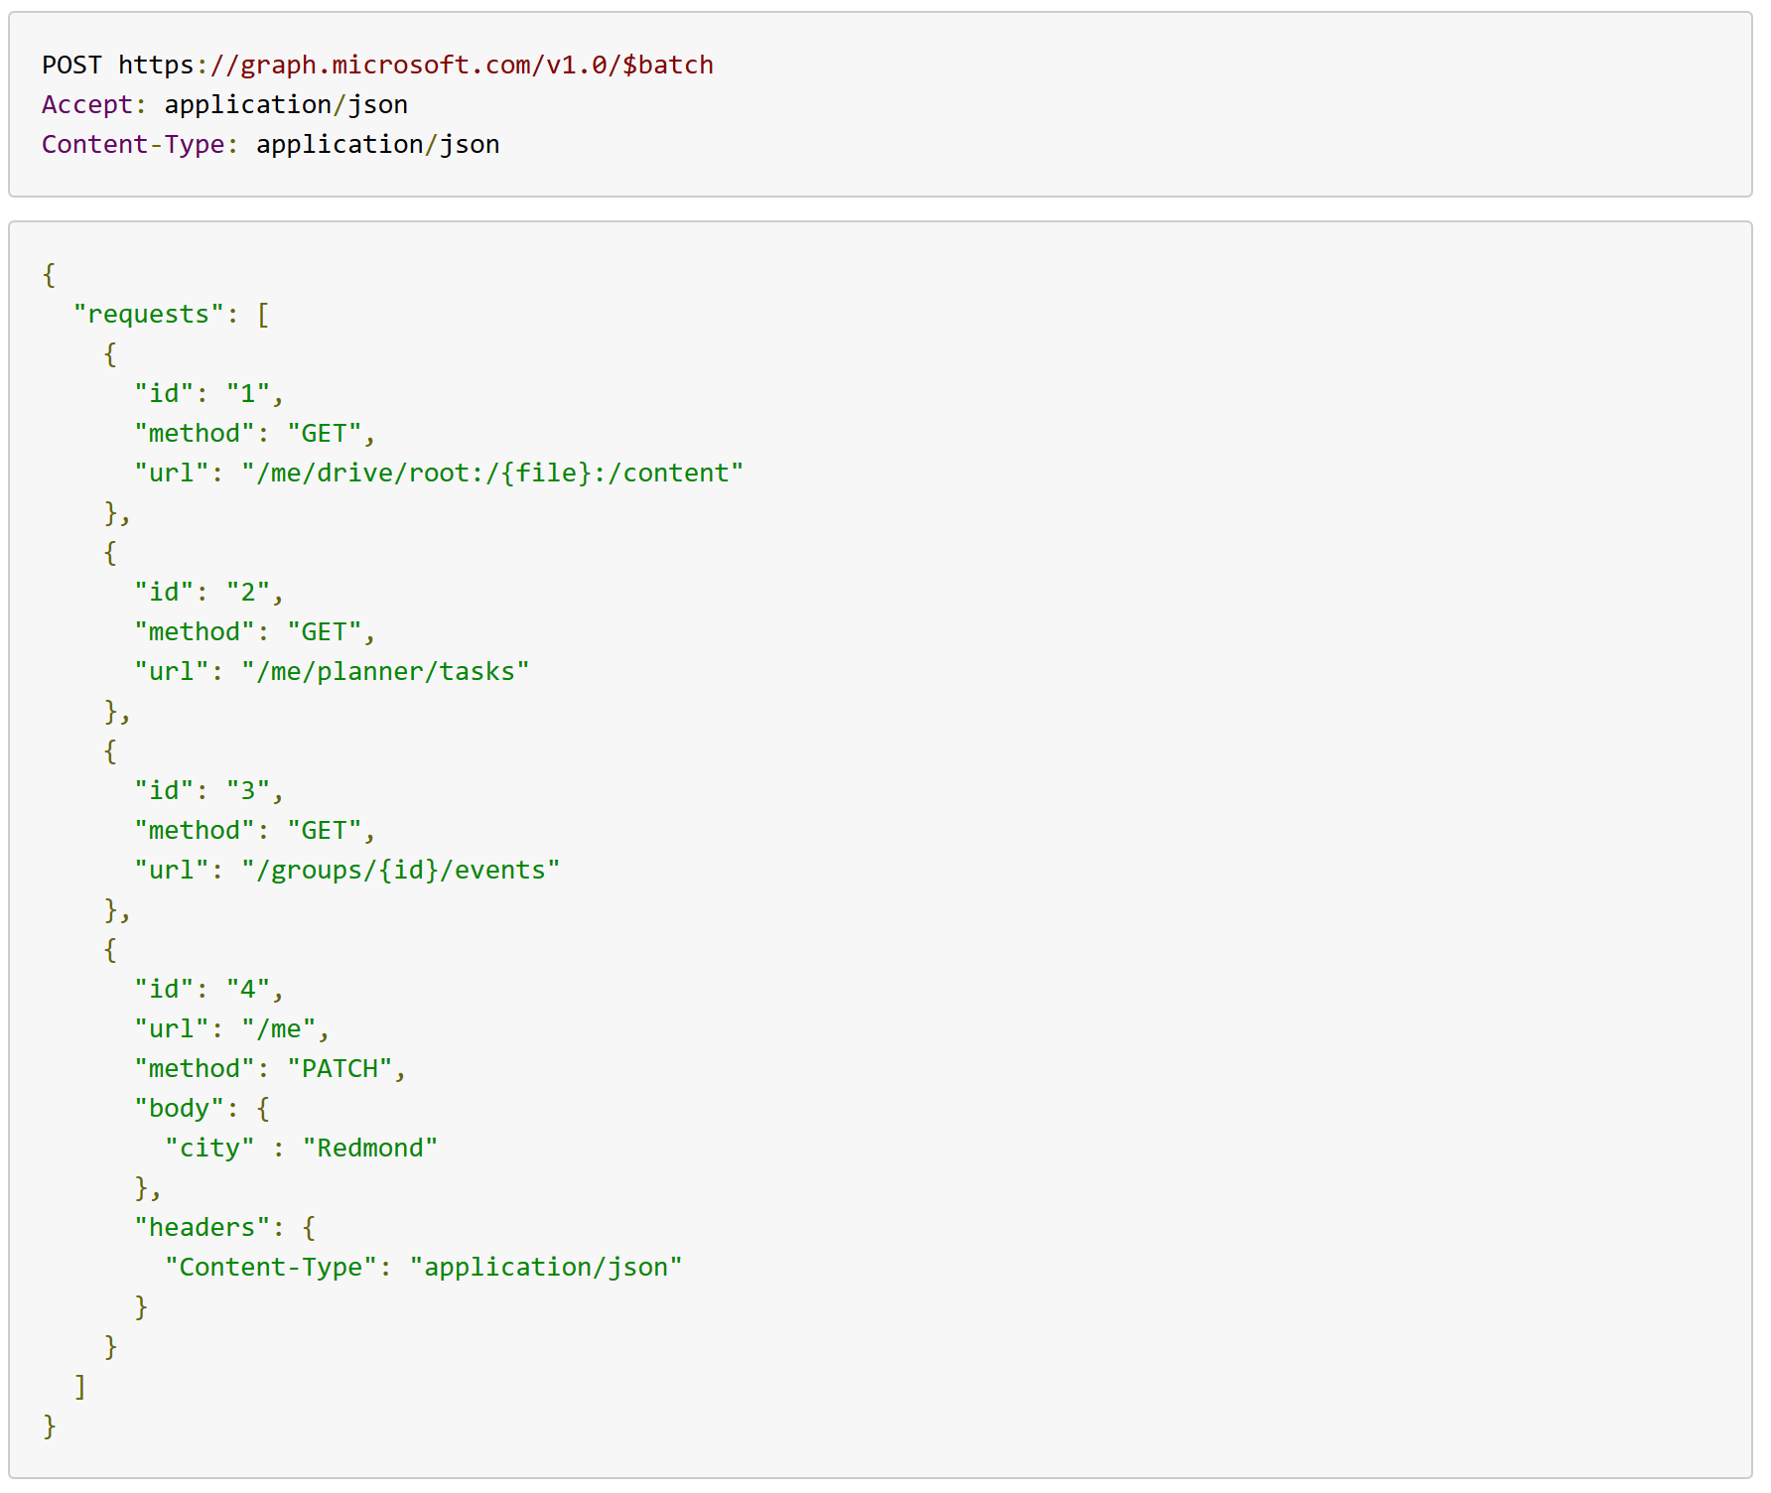
Batch Request / Response

Slide 20
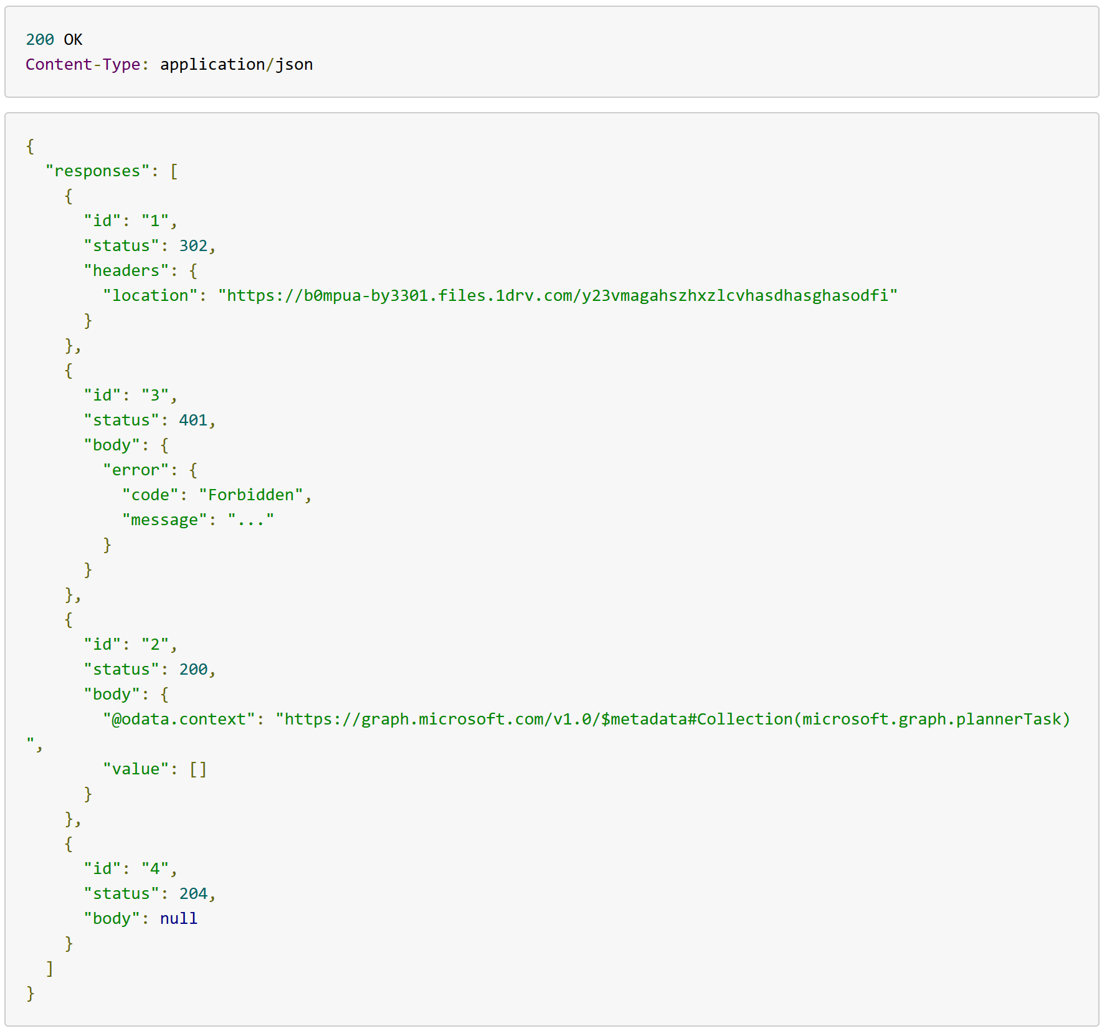
Batch Request / Response

Slide 21
Limitaciones Batch requests
No se pueden anidar peticiones Batch
No es transaccional
URIs deben ser relativas
Máximo 20 peticiones en Batch
Dependencias simples “dependsOn”

Slide 22
A que me ha quedao bonica la demo?...

Slide 23
https://github.com/luismanez/sp-saturday-barcelona-2018

Slide 24

Tips & Tricks

Slide 25

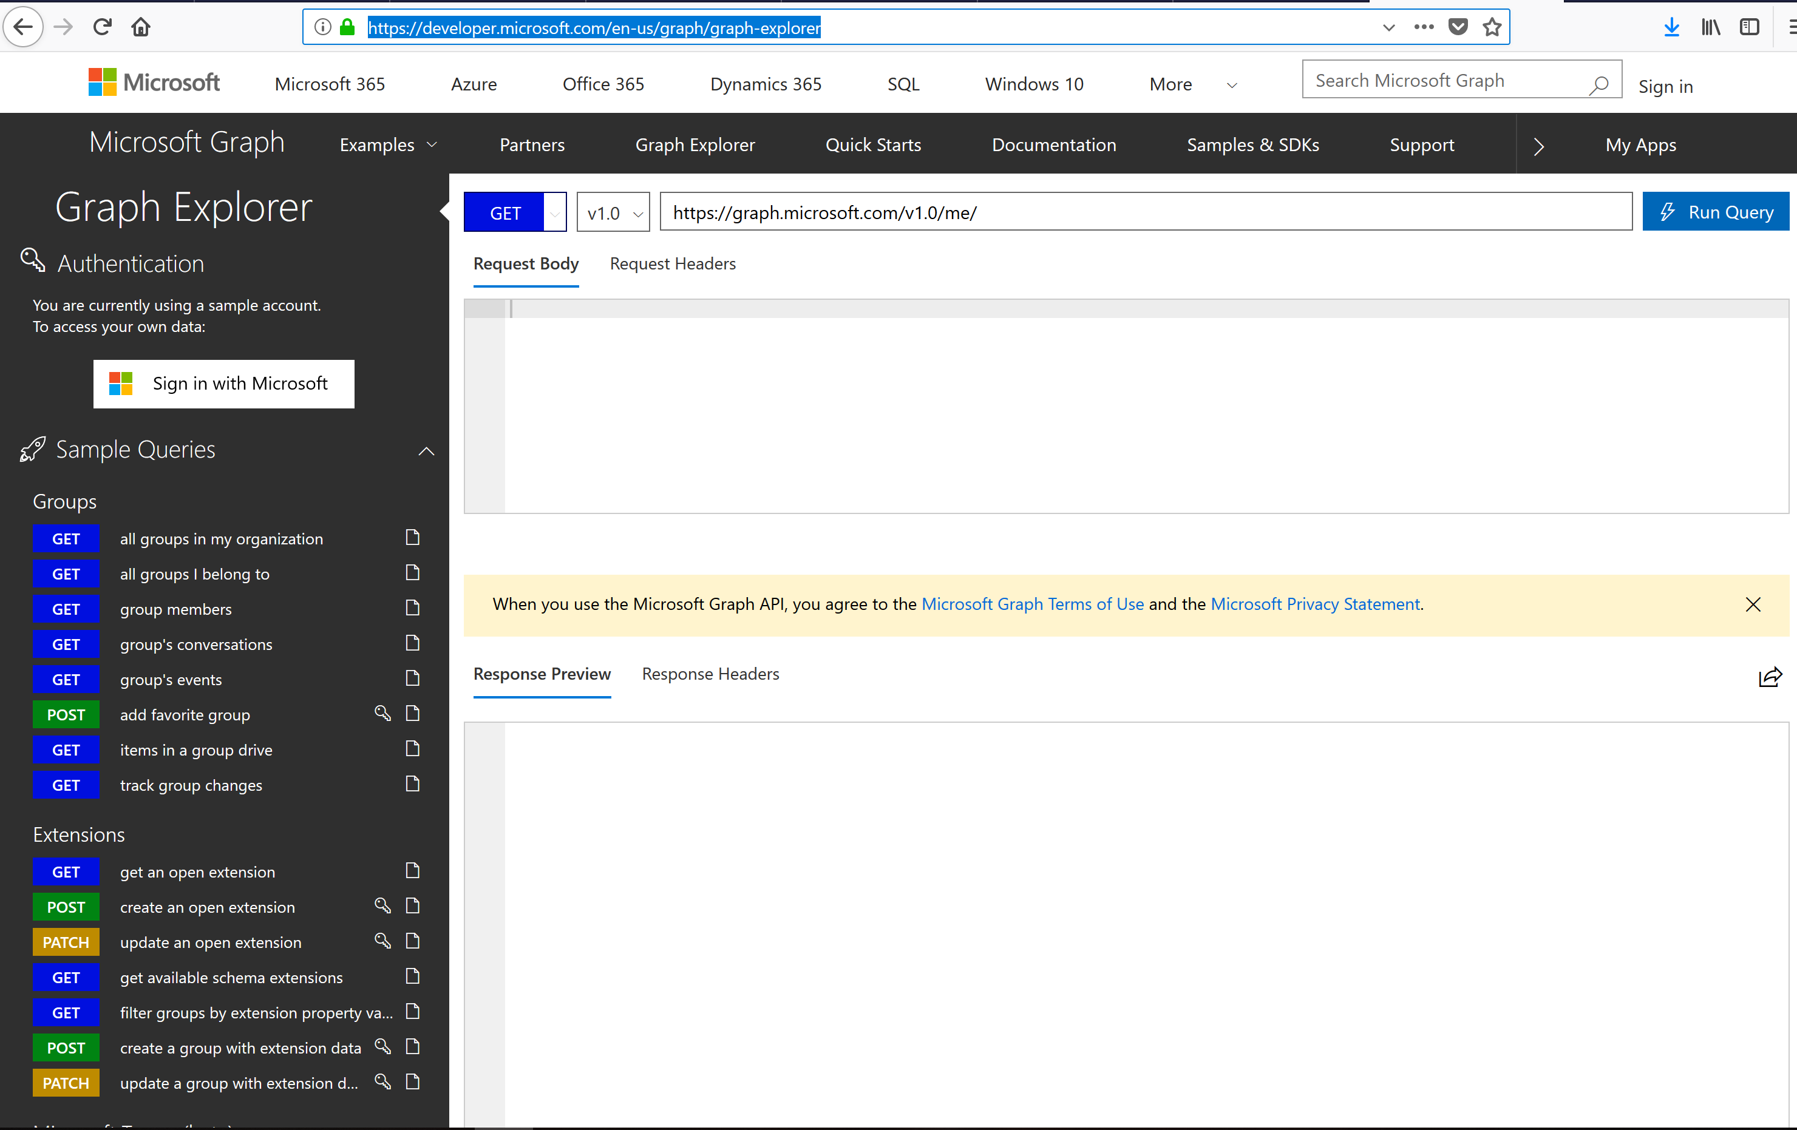
Graph explorer es tu “BFF”
1

Slide 26
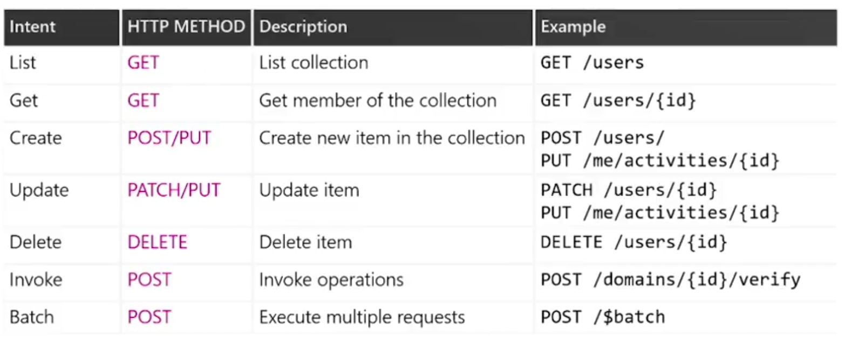
Los 7 magnificos (operaciones)
2

Slide 27
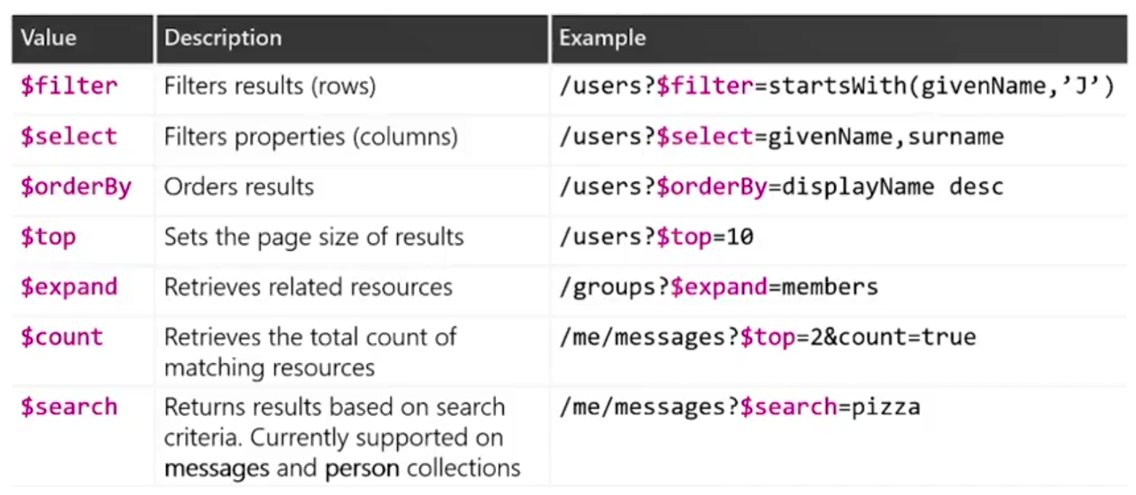
Los 7 magnificos (query parameters)
3

Slide 28
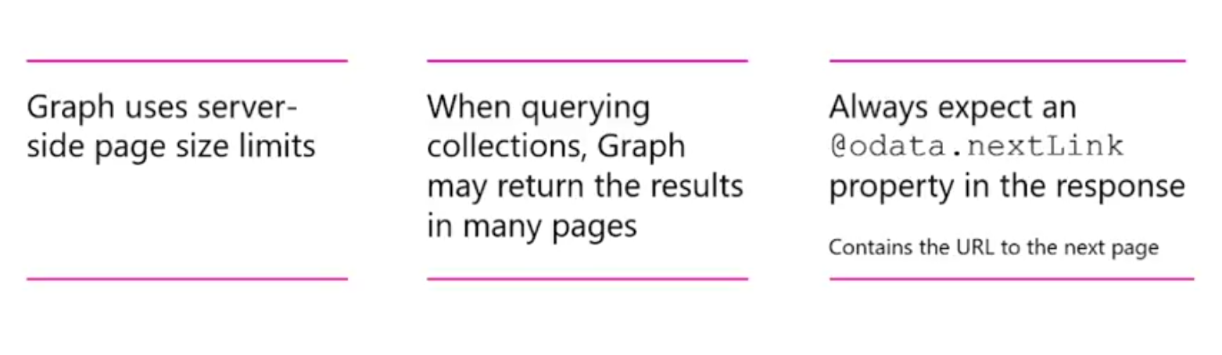
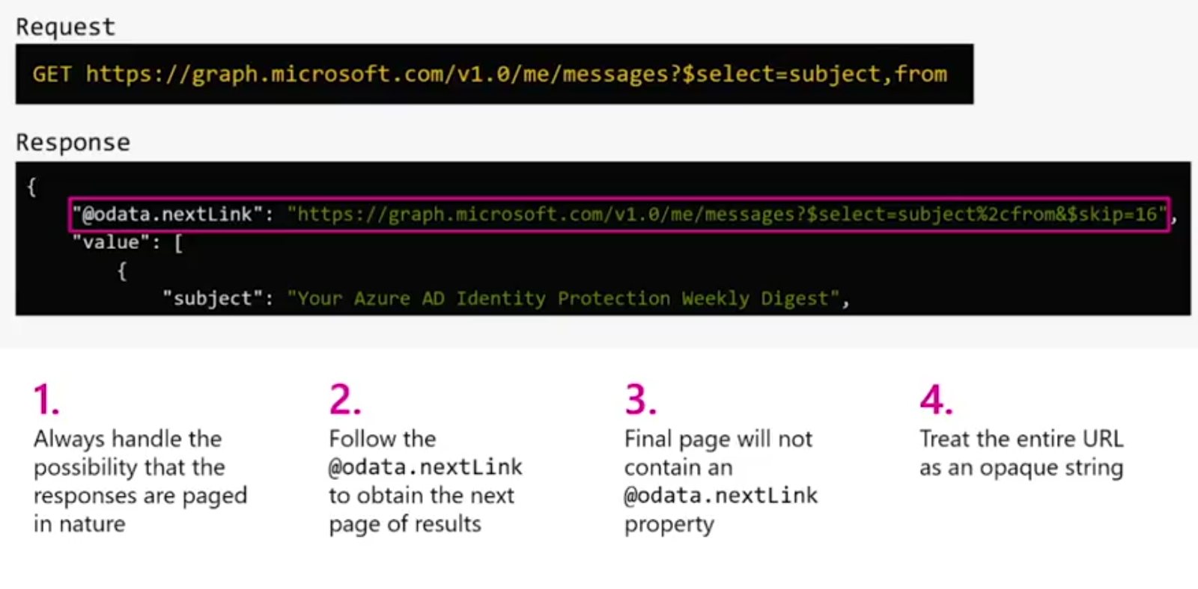
Server-side pagination
4

Slide 29
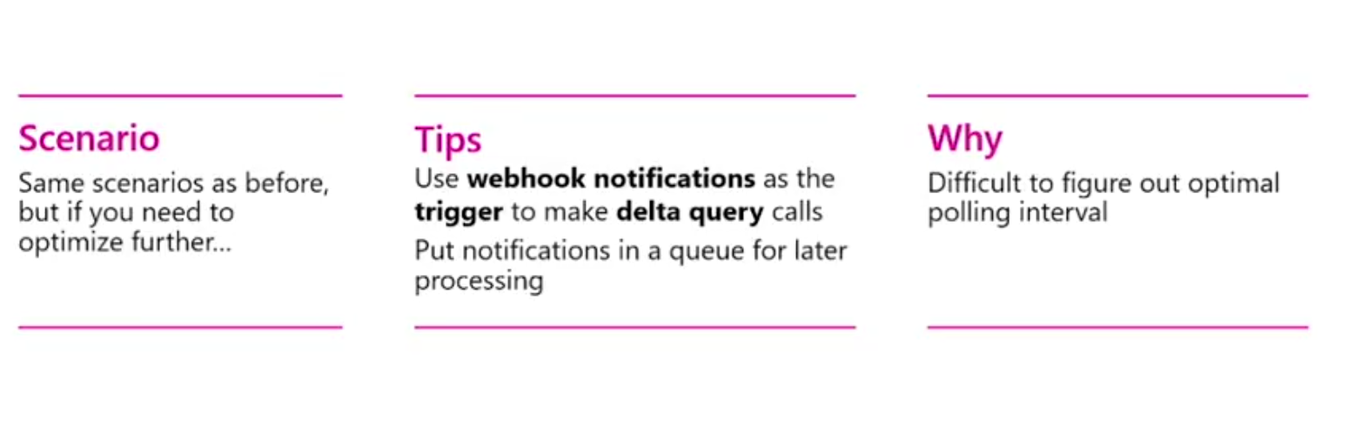
Track changes: webhooks + delta queries
5

Slide 30
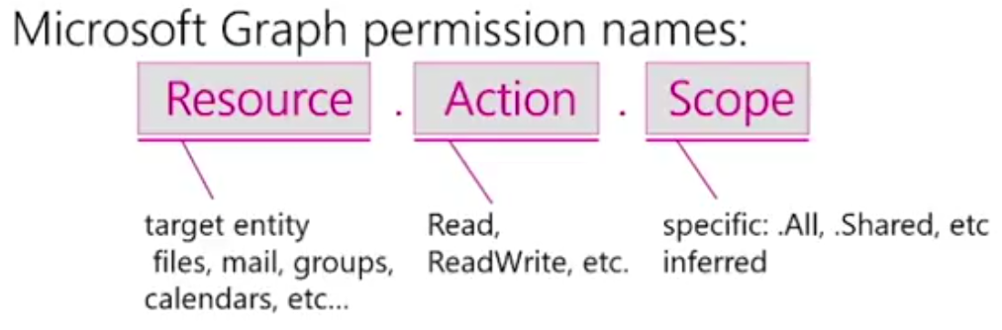
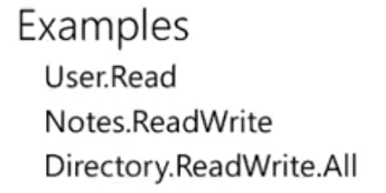
Use least privileges
6

Slide 31
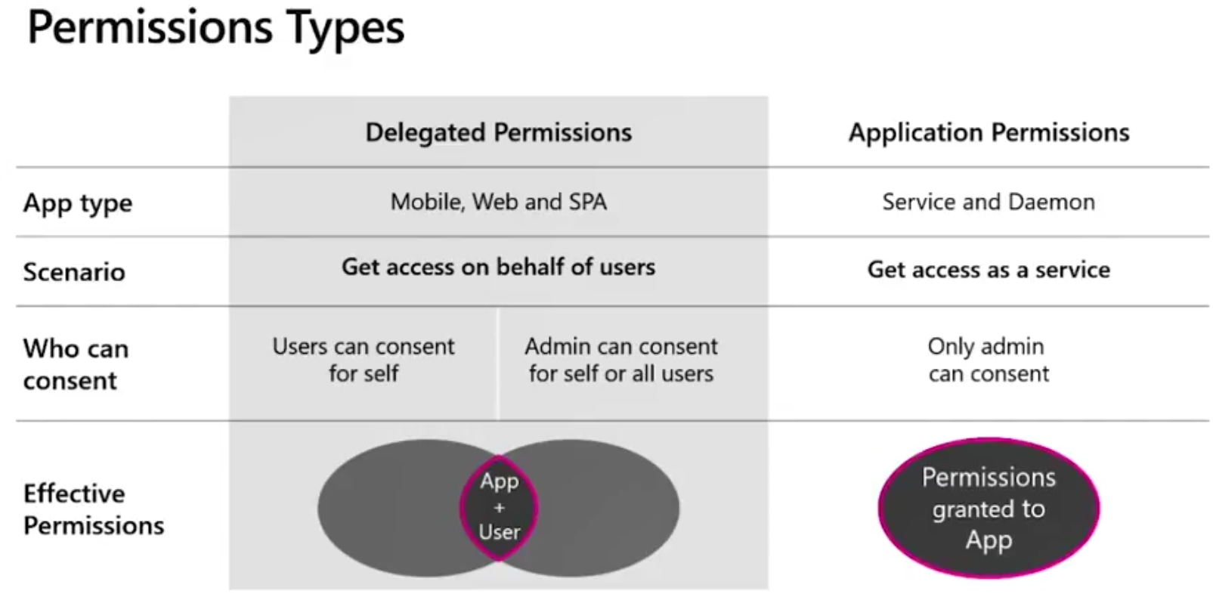
Use least privileges
6

Slide 32
Resources
MS Graph main page:
https://developer.microsoft.com/en-us/graph
MS Graph explorer:
https://developer.microsoft.com/en-us/graph/graph-explorer
Azure AD MS Graph samples
https://github.com/Azure-Samples?utf8=%E2%9C%93&q=graph&type=&language=
Ignite 2018 Microsoft Graph sessions on-demand
https://developer.microsoft.com/en-us/graph/blogs/ignite-graph-ondemand/

Slide 33
Thank you!
Questions?
#SPSBCN

